Slide 1
Adv Algorithms Final Project
Optimal Binary Search
Armin Felahatpisheh

Slide 2
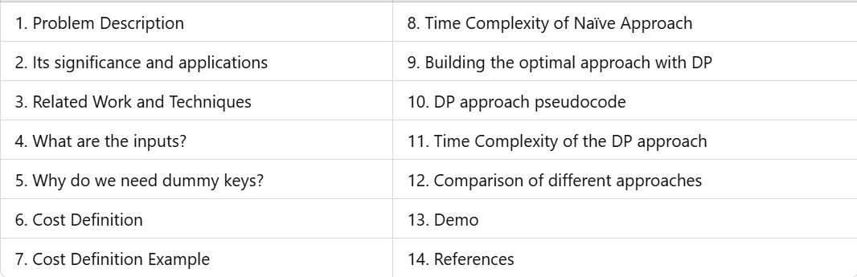
CONTENS

Slide 3
Problem Description
Organize an English dictionary in a binary search tree.
Minimize the average lookup time based on search probabilities.
Construct a tree that minimizes the expected search cost.

Slide 4
Its significance and applications
Efficient Search Operations: Reduces average search time for frequently accessed items, improving performance.
Memory Optimization: Minimizes unnecessary memory accesses for rare or non-existent queries.
Digital Dictionaries: Faster word lookups for language processing and spell-checking.
Database Indexing: Organizing database keys to improve query efficiency.
Compiler Design: Optimizing symbol tables for frequently used variables or instructions.
Data Retrieval Systems: Efficiently managing and querying large-scale hierarchical data.
Information Retrieval: Search optimization for libraries, search engines, or document systems.

Slide 5
Related Work and Techniques
Dynamic Programming: Used to solve the OBST problem efficiently by breaking it into subproblems.
Huffman Encoding: Similar concept of minimizing weighted path lengths, focusing on probabilities.
Greedy Algorithms: Explored for tree construction but lack global optimization compared to dynamic programming.
Matrix Chain Multiplication: Shares structural similarity with OBST, solved via dynamic programming.
Balanced Trees (AVL, RBT): Ensure height-balanced trees but ignore probabilistic search frequencies.
B-Trees and B+ Trees: Widely used in databases; ensure balanced structures with efficient access.
Adaptive Tree Algorithms: Dynamically reorganize trees based on access patterns, extending OBST concepts.

Slide 6
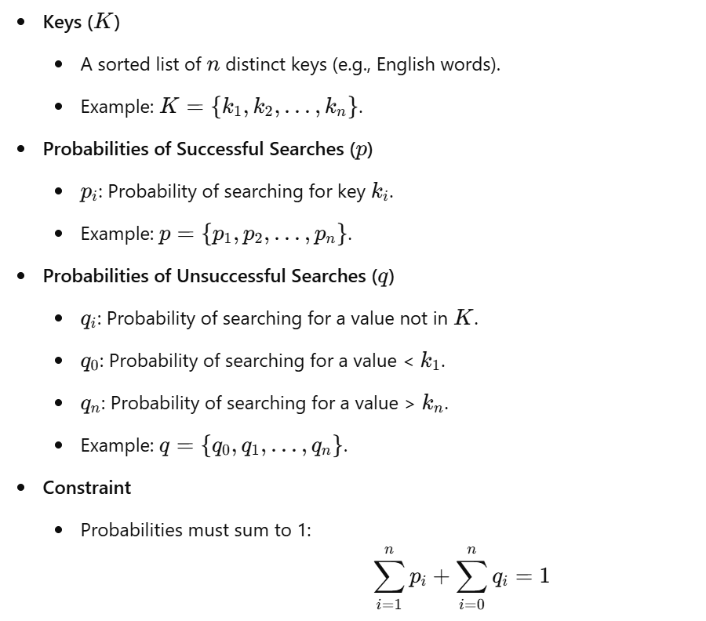
What are the inputs?

Slide 7
Why do we need dummy keys?
Dummy keys represent unsuccessful search cases in the binary search tree (BST).
They account for searches where the query is for a value not present in the set of keys.
In an optimal binary search tree, dummy keys are used to maintain the continuity of the structure and properly calculate the expected cost of all possible searches (both successful and unsuccessful).

Slide 8
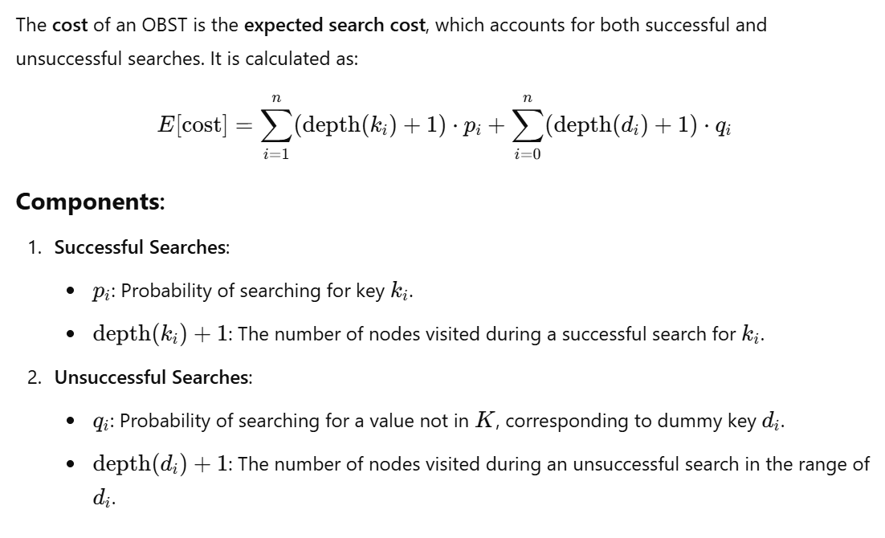
Cost Definition

Slide 9
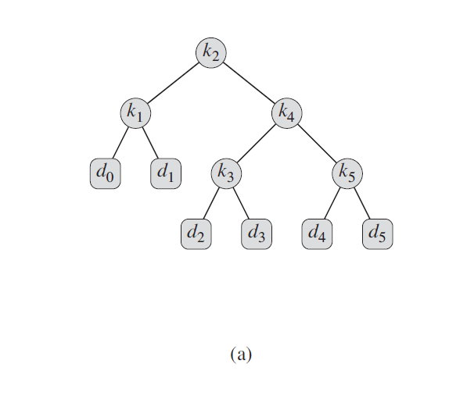
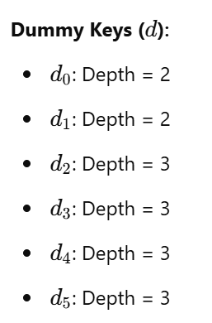
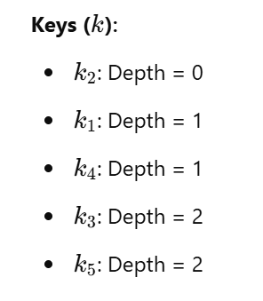
Cost Definition Example (1)

Slide 10
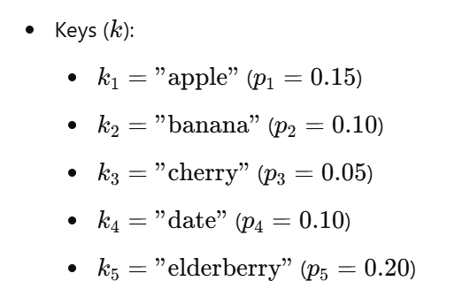
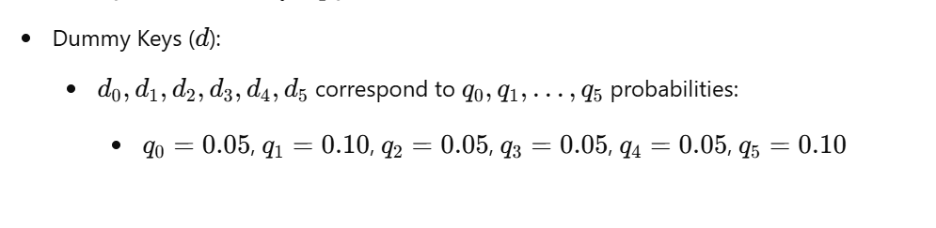
Cost Definition Example (2)

Slide 11
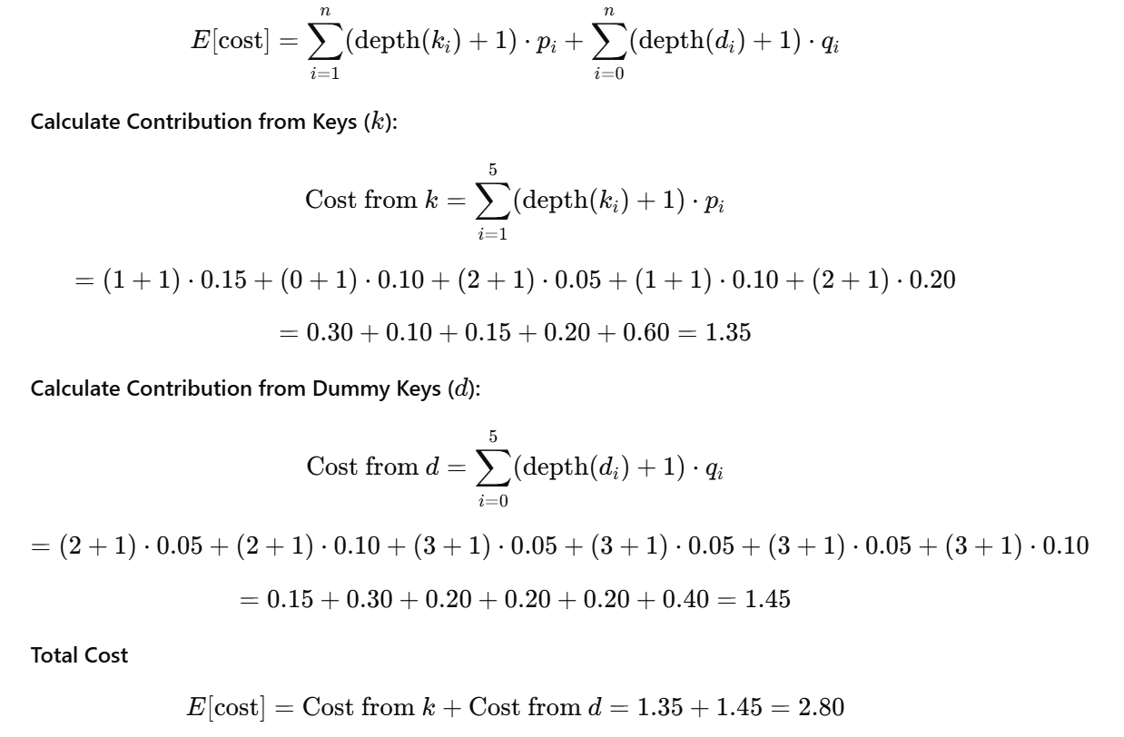
Cost Definition Example (3)

Slide 12
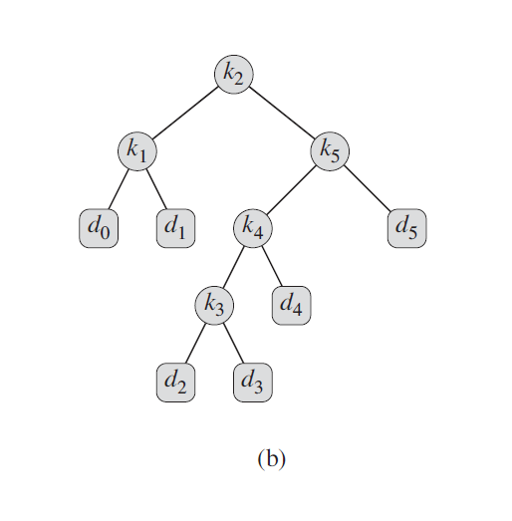
Points
The picture illustrates the Optimal BST.
This example shows that an optimal binary search tree is not necessarily a tree whose overall height is smallest.
The lowest expected cost of any binary search tree with k5 at the root is 2.85.
We cannot we necessarily construct an optimal binary search tree by always putting the key with the greatest probability at the root. (k5 has the biggest key but is not the root)

Slide 13
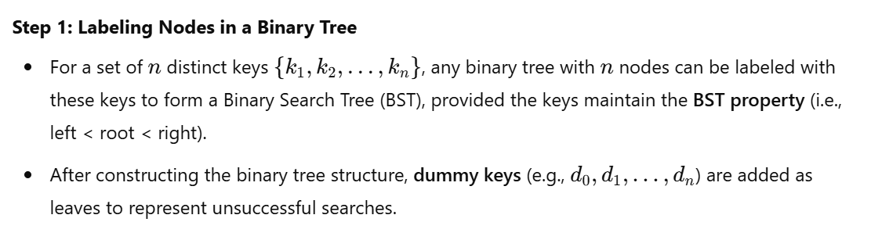
Time Complexity of Naïve Approach (1)

Slide 14
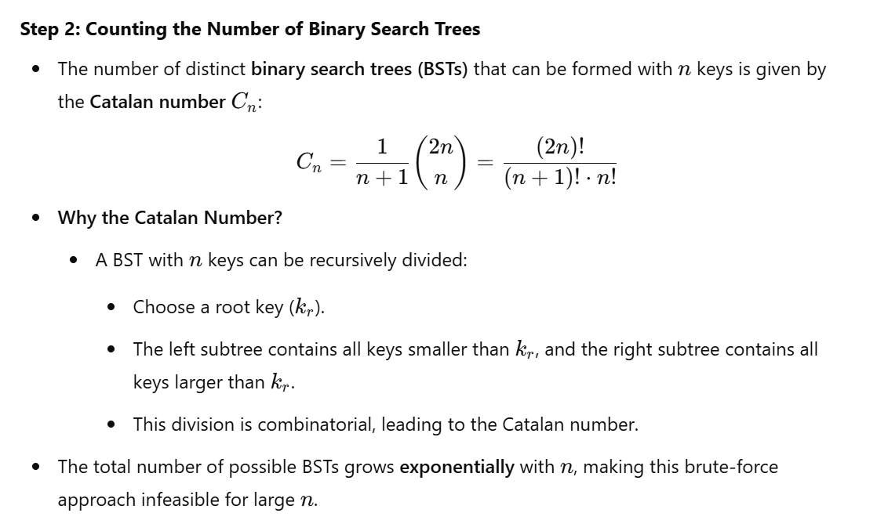
Time Complexity of Naïve Approach (2)

Slide 15
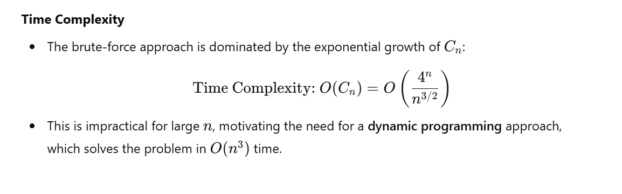
Time Complexity of Naïve Approach (3)

Slide 16
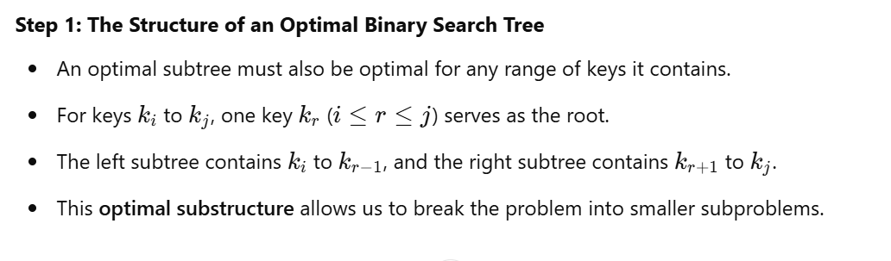
Building the optimal approach with DP (1)

Slide 17
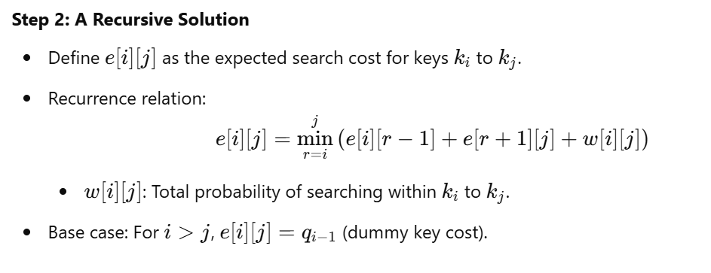
Building the optimal approach with DP (2)

Slide 18
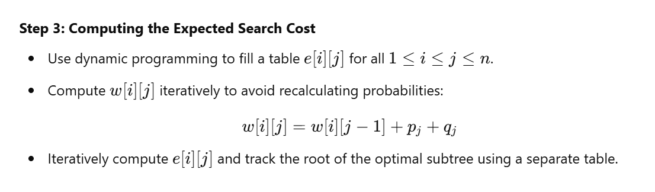
Building the optimal approach with DP (3)

Slide 19
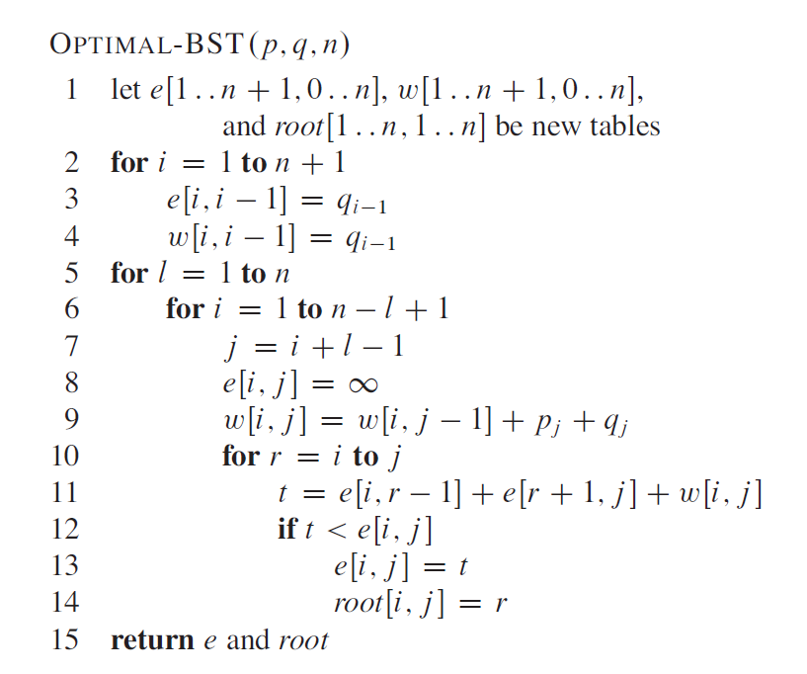
DP approach pseudocode

Slide 20
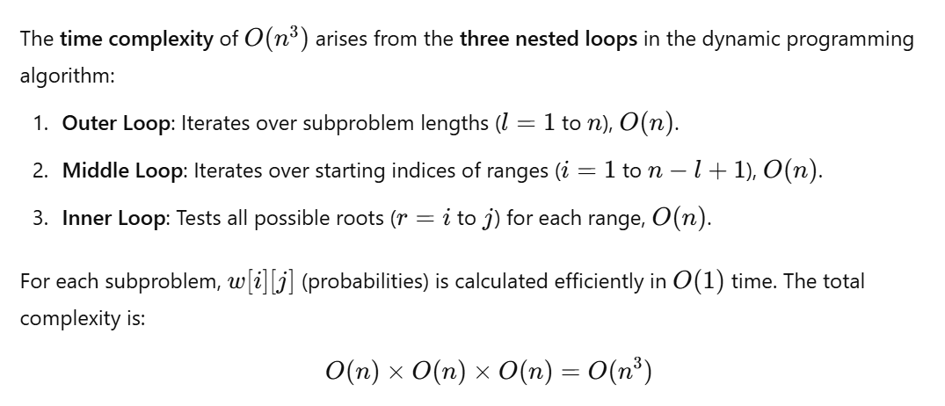
Time Complexity of the DP approach

Slide 21
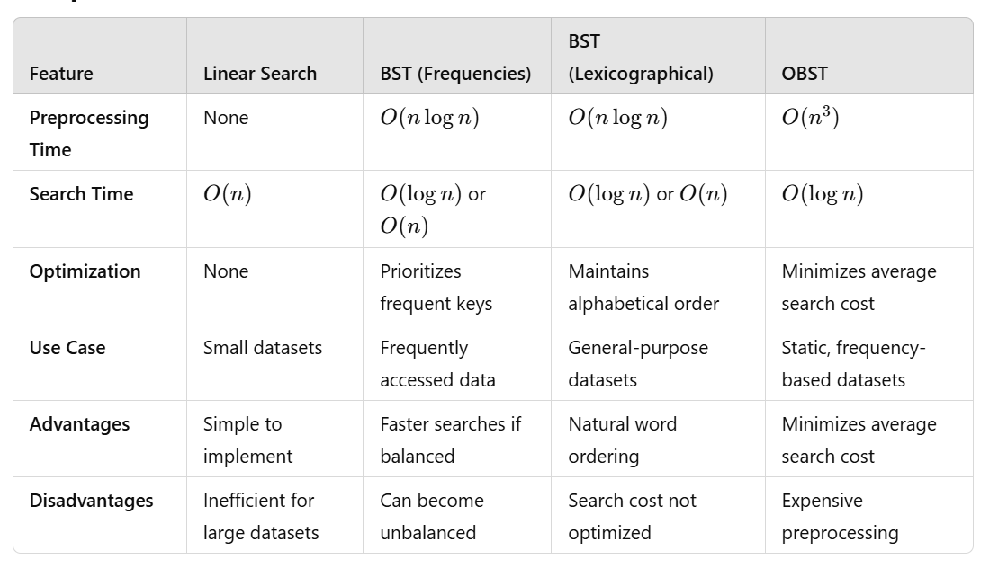
Comparison of different approaches

Slide 22
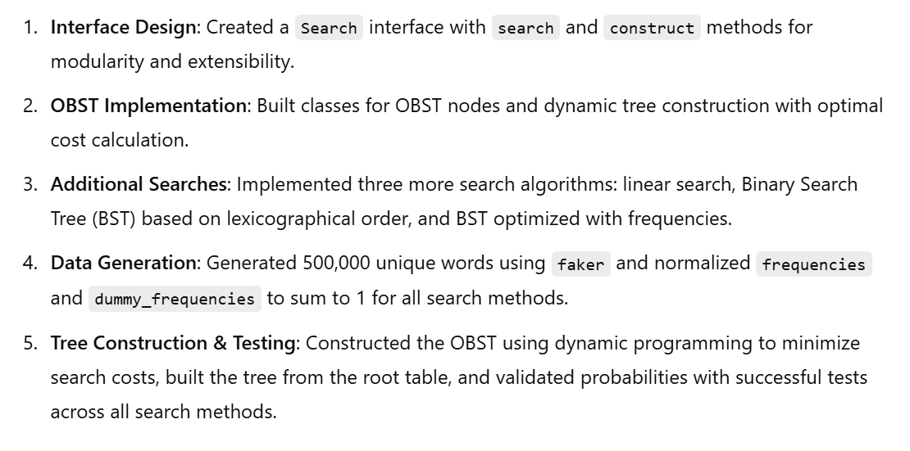
Demo

Slide 23
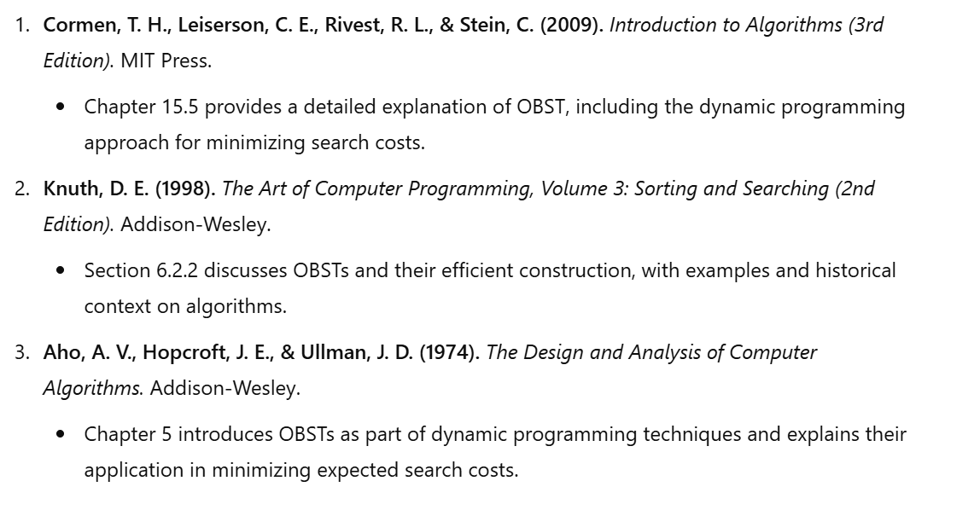
References

Slide 24

Thank you.
Lorem ipsu 01

